Slide 1

Digital Image Processing Project: Counterfeit Currency Detection
A Machine Learning approach using Digital Image Processing (DIP) to safeguard financial security by identifying sophisticated counterfeits.

Slide 2

Presentation Agenda
Project Overview & Core Components
Problem & Objectives
1
Defining the scope and goals.
Methodology
2
DIP Techniques and ML Model Selection.
Implementation
3
Feature extraction and model training.
Demonstration
4
Live testing and results analysis.

Slide 3

The Problem: An Escalating Security and Financial Concern
Clear Problem Definition
Counterfeit currency poses a significant threat to global finance, requiring fast, reliable, and automated detection systems beyond human capability.
Key Objectives
Develop a model to differentiate real (Class 0) from fake (Class 1) currency notes.
Leverage DIP techniques to extract unique, non-visible patterns and textures.
Achieve high accuracy and minimize false negatives (undetected fakes).

Slide 4



The Toolkit: Digital Image Processing Fundamentals
To distinguish between real and counterfeit notes, we employ advanced DIP techniques to capture subtle differences in visual characteristics.
Texture Analysis (LBP)
Edge Detection (Canny)
Histogram Analysis
Using Local Binary Pattern (LBP) to describe the microscopic texture of the note's surface, which counterfeits struggle to replicate precisely.
Identifying and quantifying the sharpness and density of printed lines and micro-text, which are often blurred or inconsistent in fakes.
Analyzing the distribution of pixel intensities to detect anomalies in ink color, density, and print quality across the note.
These extracted visual properties form the core feature vector for our machine learning classifiers.

Slide 5

Dataset Structure and Preparation
Our project utilizes a structured Currency Dataset, essential for robust supervised learning.
Organized Data Paths
The dataset is logically partitioned into Training and Testing sets, with subfolders for real (0) and fake (1) notes.
Size and Balance
The training and testing sets must contain a balanced mix of real and fake samples to prevent model bias and ensure reliable generalization.
Example: Training set (Real + Fake samples); Testing set (unseen Real + Fake samples).

Slide 6




Methodology: Feature Extraction and Modeling Pipeline
Image Acquisition
Pre-processing & DIP
Load the 'Currency Dataset' with separate training and testing partitions for "real" (0) and "fake" (1) samples.
Images are resized and converted to grayscale. Features (LBP, Histogram, Edges, Intensity Stats) are extracted from each note.
Feature Scaling
ML Training
Features are normalized using StandardScaler to ensure all features contribute equally to the model training process.
Scaled features are used to train multiple classifiers, including Random Forest, SVM, and Logistic Regression.

Slide 7
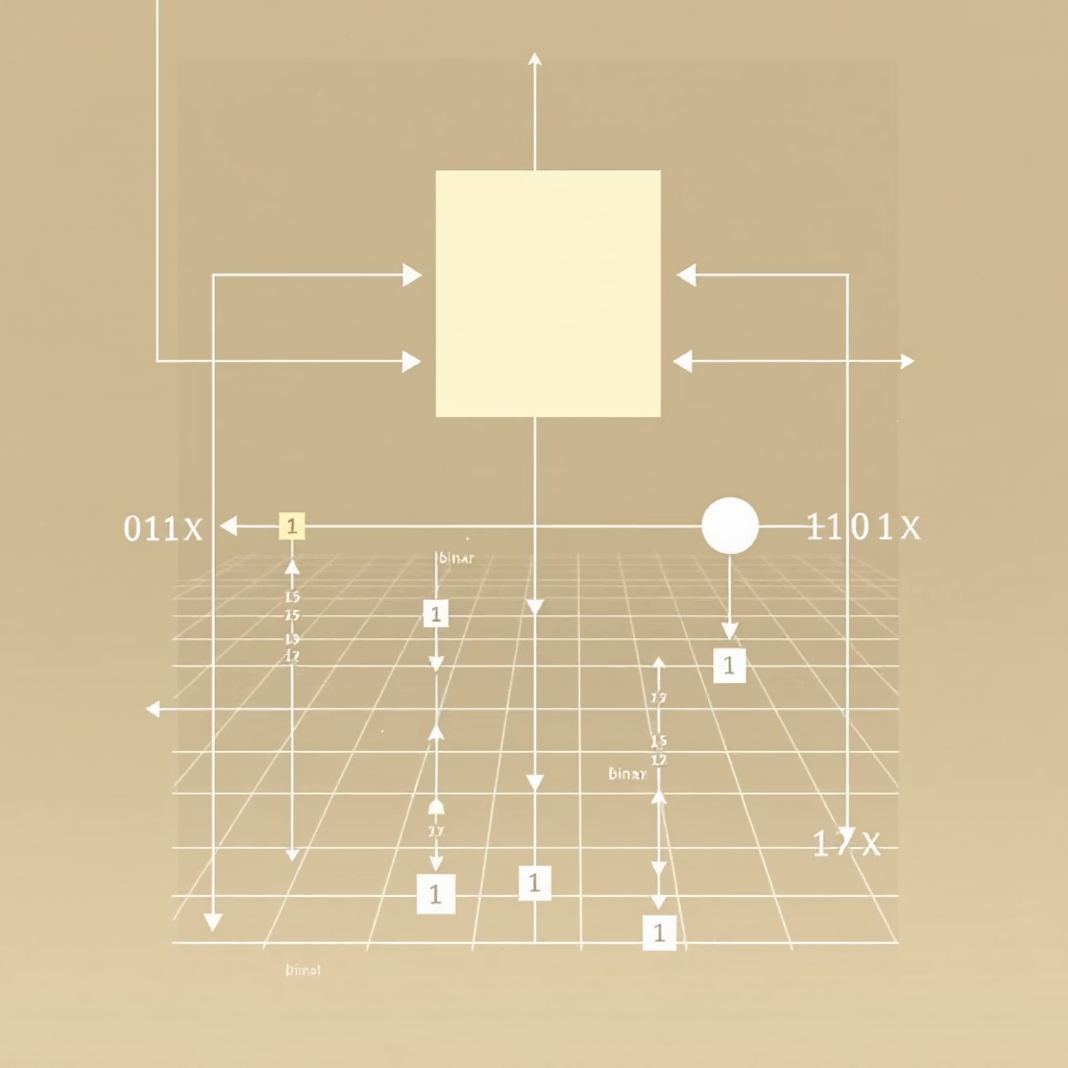
Core Feature: Local Binary Pattern (LBP) for Texture
LBP is a powerful descriptive operator used for texture classification, forming the backbone of our counterfeit detection.
What LBP Does
LBP compares a central pixel's intensity with its neighbors, generating a binary code that represents the texture pattern around that pixel.
Why It's Key
The intricate printing texture of real currency results in distinct LBP patterns that are difficult to reproduce consistently in lower-quality counterfeits.
Feature Vector
We extract the mean and standard deviation of the calculated LBP image, adding texture variability to our feature set.

Slide 8


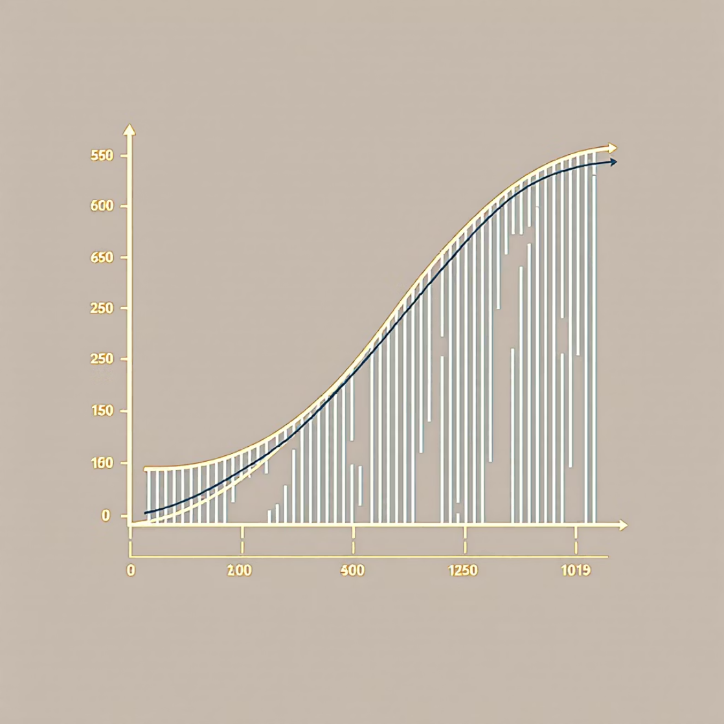
Comparative Model Training and Tuning
We evaluated three distinct classifiers to find the most effective algorithm for our complex, multi-feature dataset.
Random Forest
Support Vector Machine (SVM)
Logistic Regression
An ensemble method, highly effective for non-linear data and reducing overfitting. Used as our baseline and optimized using GridSearchCV for best performance.
Uses a Radial Basis Function (RBF) kernel to map features into a higher-dimensional space, ideal for complex, non-separable data points.
A linear model that serves as a simple benchmark to gauge the linear separability of our extracted features.
Hyperparameter tuning on Random Forest yielded the 'Best RF' model, which was saved for deployment.

Slide 9
1.Dataset Summary:
Set | Real | Fake | Total
Training Set | 1387 | 1387 | 2774
Testing Set | 265 | 297 | 562
Feature Extraction Summary:
Process | Samples Processed | Duration | Features Extracted
Training Features | 2774 | ~1 min 45 sec | 17
Testing Features | 562 | ~21 sec | 17
Feature Matrix Shapes:
Training: (2774, 17)
Testing: (562, 17)

Slide 10
2. Model Performance Comparison
a) Logistic Regression:
Metric | Score
Accuracy | 0.6904
ROC AUC | 0.7726
 | Predicted: Real (0) | Predicted: Fake (1)
Actual: Real (0) | 184 | 81
Actual: Fake (1) | 93 | 204
Confusion Matrix
Classification Report
Class | Precision | Recall | F1-Score | Support
0 (Real) | 0.66 | 0.69 | 0.68 | 265
1 (Fake) | 0.72 | 0.69 | 0.70 | 297
Accuracy |  |  | 0.69 | 562
Macro Avg | 0.69 | 0.69 | 0.69 | 562
Weighted Avg | 0.69 | 0.69 | 0.69 | 562

Slide 11
(b) Support Vector Machine (SVM):
Metric | Score
Accuracy | 0.7509
ROC AUC | 0.8321
 | Predicted: Real (0) | Predicted: Fake (1)
Actual: Real (0) | 195 | 70
Actual: Fake (1) | 70 | 227
Confusion Matrix
Classification Report
Class | Precision | Recall | F1-Score | Support
0 (Real) | 0.74 | 0.74 | 0.74 | 265
1 (Fake) | 0.76 | 0.76 | 0.76 | 297
Accuracy |  |  | 0.75 | 562
Macro Avg | 0.75 | 0.75 | 0.75 | 562
Weighted Avg | 0.75 | 0.75 | 0.75 | 562

Slide 12
(c) Random Forest (Baseline):
Metric | Score
Accuracy | 0.7687
ROC AUC | 0.8582
 | Predicted: Real (0) | Predicted: Fake (1)
Actual: Real (0) | 211 | 54
Actual: Fake (1) | 76 | 221
Confusion Matrix
Classification Report
Class | Precision | Recall | F1-Score | Support
0 (Real) | 0.74 | 0.80 | 0.76 | 265
1 (Fake) | 0.80 | 0.74 | 0.77 | 297
Accuracy |  |  | 0.77 | 562
Macro Avg | 0.77 | 0.77 | 0.77 | 562
Weighted Avg | 0.77 | 0.77 | 0.77 | 562

Slide 13
4. Optimized Random Forest Model (Final Model):
Metric | Score
Accuracy | 0.7687
ROC AUC | 0.8615
 | Predicted: Real (0) | Predicted: Fake (1)
Actual: Real (0) | 210 | 55
Actual: Fake (1) | 75 | 222
Confusion Matrix
Classification Report
Class | Precision | Recall | F1-Score | Support
0 (Real) | 0.74 | 0.79 | 0.76 | 265
1 (Fake) | 0.80 | 0.75 | 0.77 | 297
Accuracy |  |  | 0.77 | 562
Macro Avg | 0.77 | 0.77 | 0.77 | 562
Weighted Avg | 0.77 | 0.77 | 0.77 | 562

Slide 14
5. Model Comparison Summary
Model | Accuracy | ROC AUC | Observation
Logistic Regression | 0.6904 | 0.7726 | Baseline linear model; decent discrimination
SVM | 0.7509 | 0.8321 | Better boundary separation than Logistic Regression
Random Forest (Baseline) | 0.7687 | 0.8582 | Strong generalization performance
Random Forest (Tuned) | 0.7687 | 0.8615 | Slight AUC improvement after tuning
6. Conclusion
The Random Forest classifier demonstrated the best overall performance, achieving 77% accuracy and ROC AUC of 0.8615.
The model achieved a good balance between precision and recall for both real and fake classes.
Hyperparameter tuning improved the ROC AUC slightly, confirming that the model was already near optimal.
The trained model and feature scaler were successfully saved for future inference.

Slide 15

Implementation & Demonstration: The Prediction Workflow
This section demonstrates the full pipeline, from input image to final prediction, showcasing the intermediate DIP steps.
01
Load Model & Scaler
The saved rf_currency_detector.pkl (Best RF model) and scaler_currency.pkl are loaded.
02
Extract Features
The extract_features() function processes the new image to calculate LBP, Edges, Histogram, etc., matching the training process.
03
Scale and Predict
The feature vector is scaled using the loaded scaler, ensuring prediction operates on normalized data, followed by model prediction and probability calculation.
04
Result Visualization
The visualize_image_processing() function displays the original image, key DIP stages (e.g., LBP texture map), and the final "Real/Fake" prediction confidence.

Slide 16


Input and output of images:
Input Image:
Output images:
Histogram equalized:
:

Slide 17
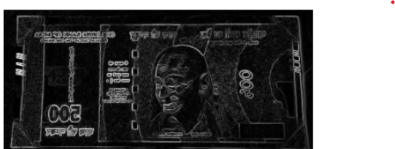
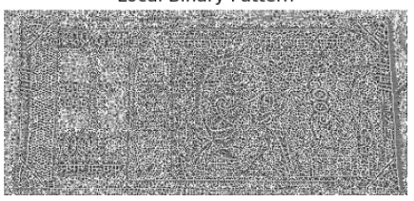
Edge map:
Local binary system:
Final output:
Prediction: Fake (64.00% confidence)

Slide 18
Explaination of confidence using a example:
if output says Real (18.50% confidence), it means:
P(Real) = 0.185
P(Fake) = 1 - 0.185 = 0.815
But because of how the model’s label mapping works (where 0 = Real and 1 = Fake), the displayed confidence corresponds to the “Fake” class.
So, your image was classified as Real, but the probability of being Fake was only 18.5%. Hence, the model is quite confident it’s Real (since Fake probability is low).
If output says Fake (64.00% confidence), it means:
P(Fake) =0.64
P(Real)=1-0.64=0.36
Because of how the model’s label mapping works( 0 = Real, 1 = Fake ), the displayed confidence corresponds to the Fake (Class 1) probability.
So, your image was classified as Fake, and the probability of being Fake is 64%. Hence, the model is 64% confident that the note is counterfeit, and only 36% confident it’s real.

Slide 19




Key Takeaways & Future Directions
Unique Features
Success in DIP Application
Integration of advanced texture metrics (LBP) over simple color/shape features enhances security and originality.
The combination of LBP texture and Canny edge features provides sufficient differentiation for high-accuracy classification.
Scalability
Superior Performance
The lightweight feature set allows for fast prediction times, making the system viable for real-time deployment in ATMs or counting machines.
The optimized Random Forest classifier demonstrated high accuracy and robustness on the unseen test data.
Thank you. We are now open for questions regarding the project implementation and analysis.

